Slide 1
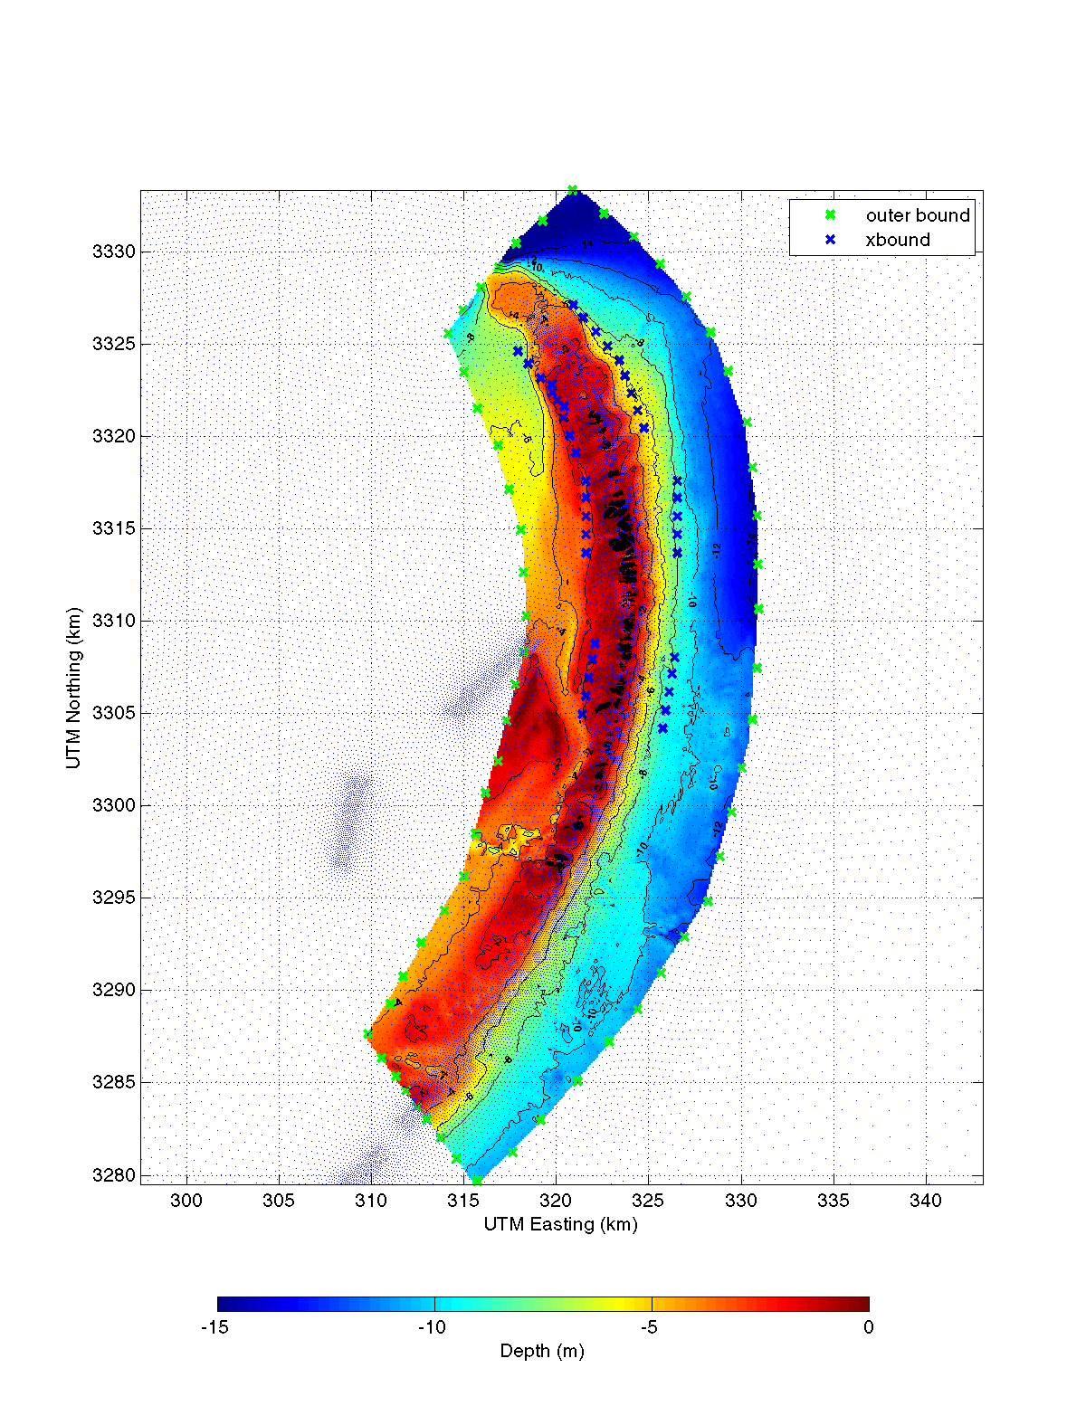
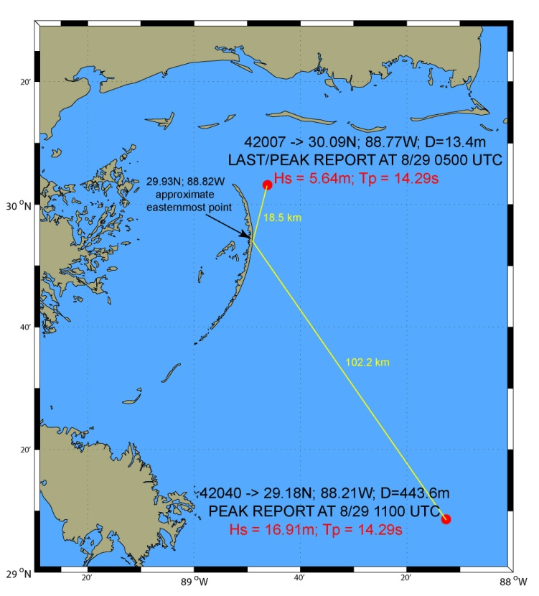
What we have from the USACE.
1
Plots in next slide are of
these offshore points (1, 13 & 26)
Compared to NDBC buoys 42007
And 42040..
All these little blue
Dots are ADCIRC nodes.
13
~7km & ~12m
KATRINA peak waves
We requested ADCIRC and
STWAVE output at the green
and blue x’s.
26

Slide 2
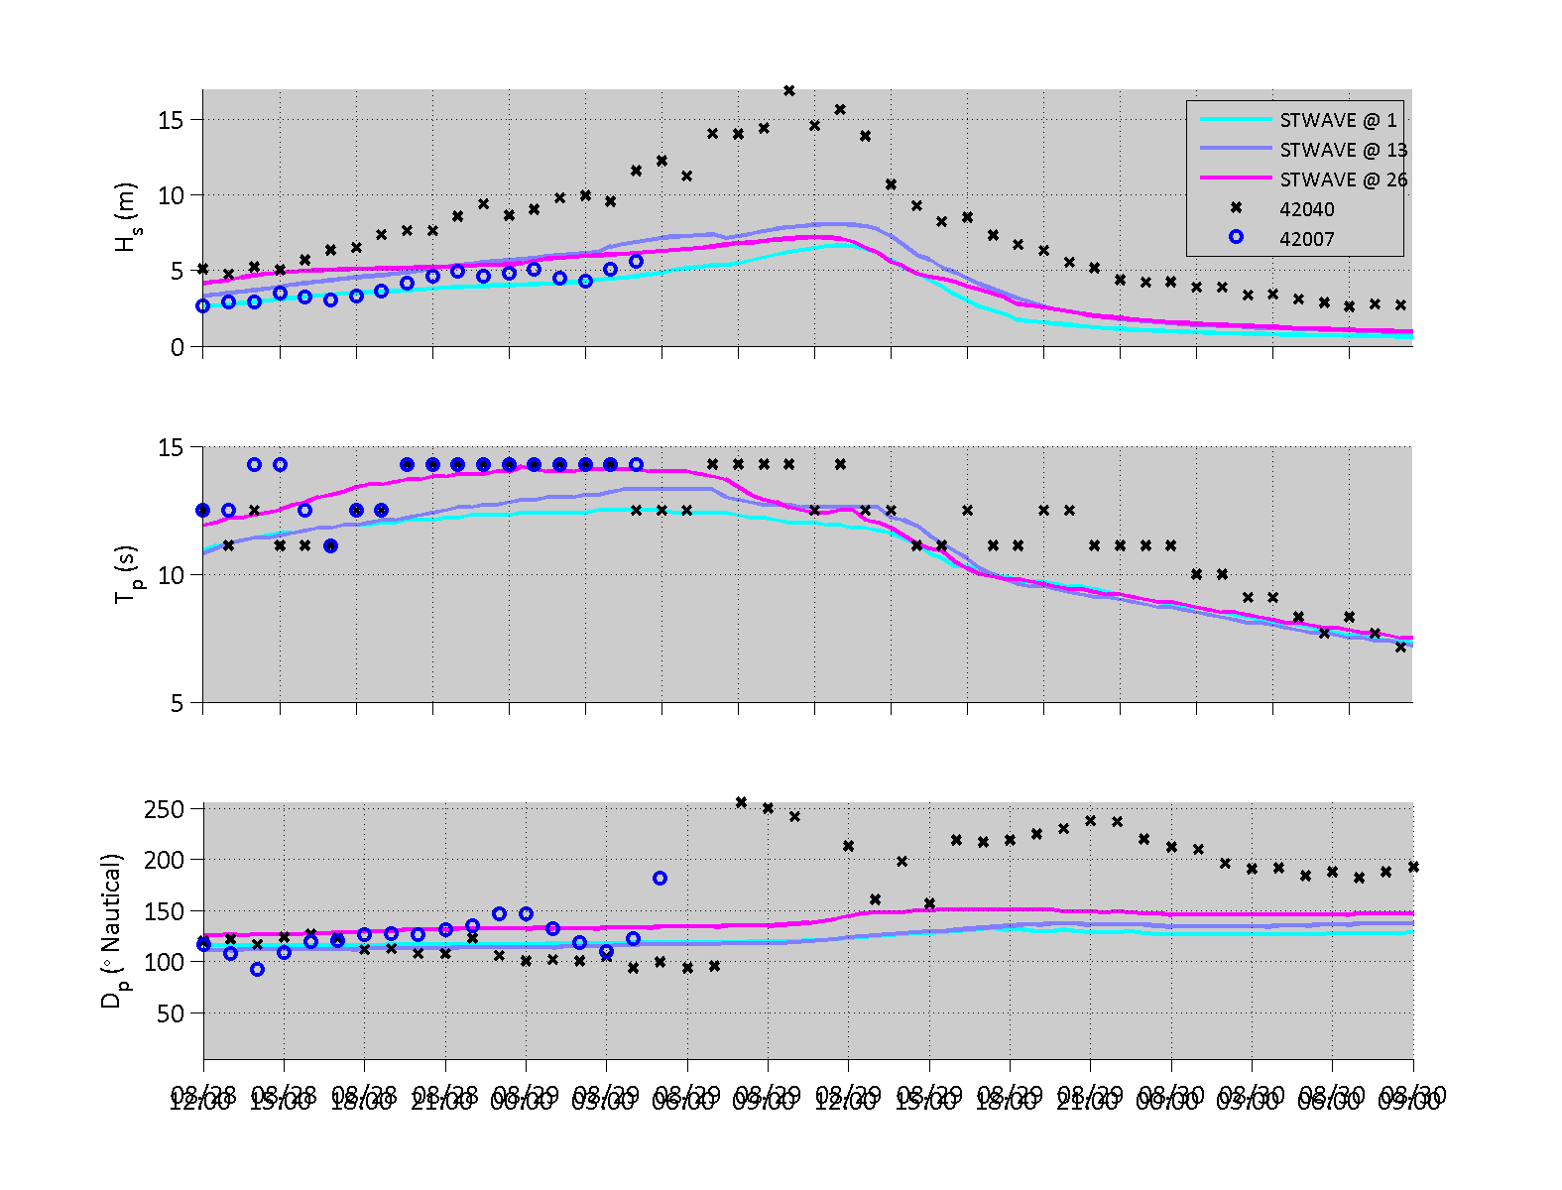

Slide 3
